Slide 1
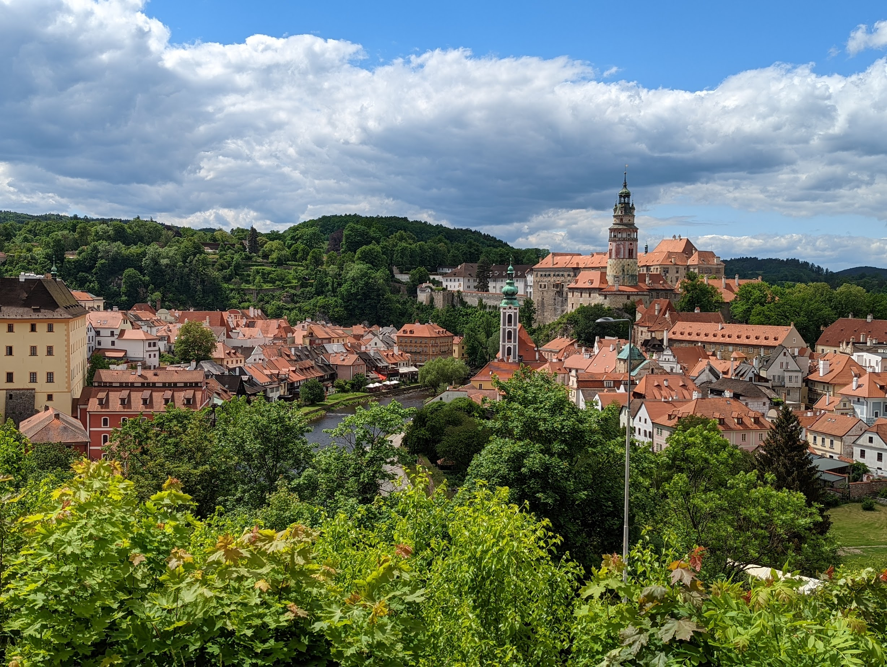
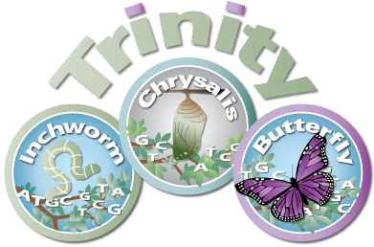
The Krumlov Intro to Trinity RNA-seq
Brian Haas
Broad Institute
Workshop on Genomics, Cesky Krumlov, May 2023

Slide 2
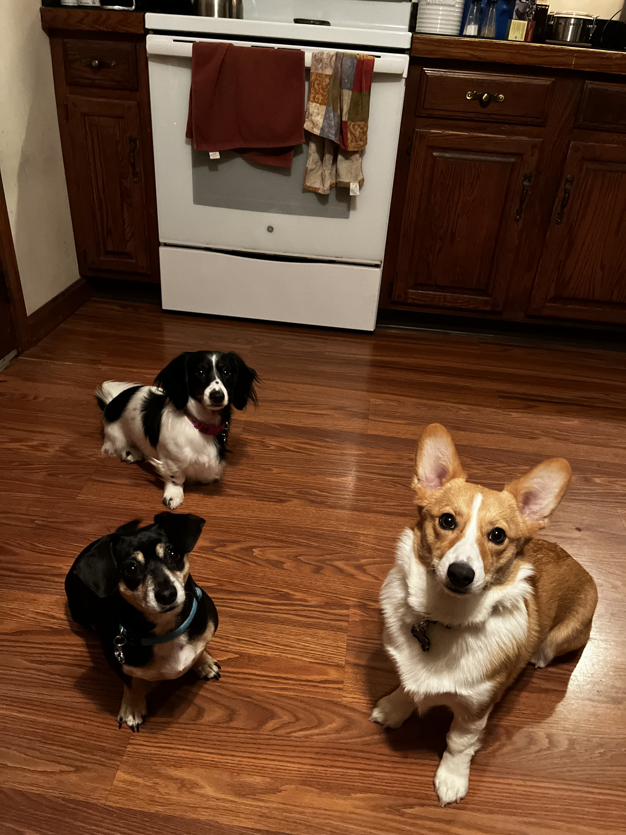
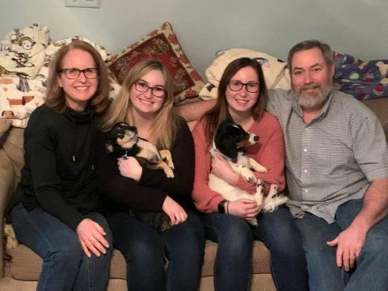
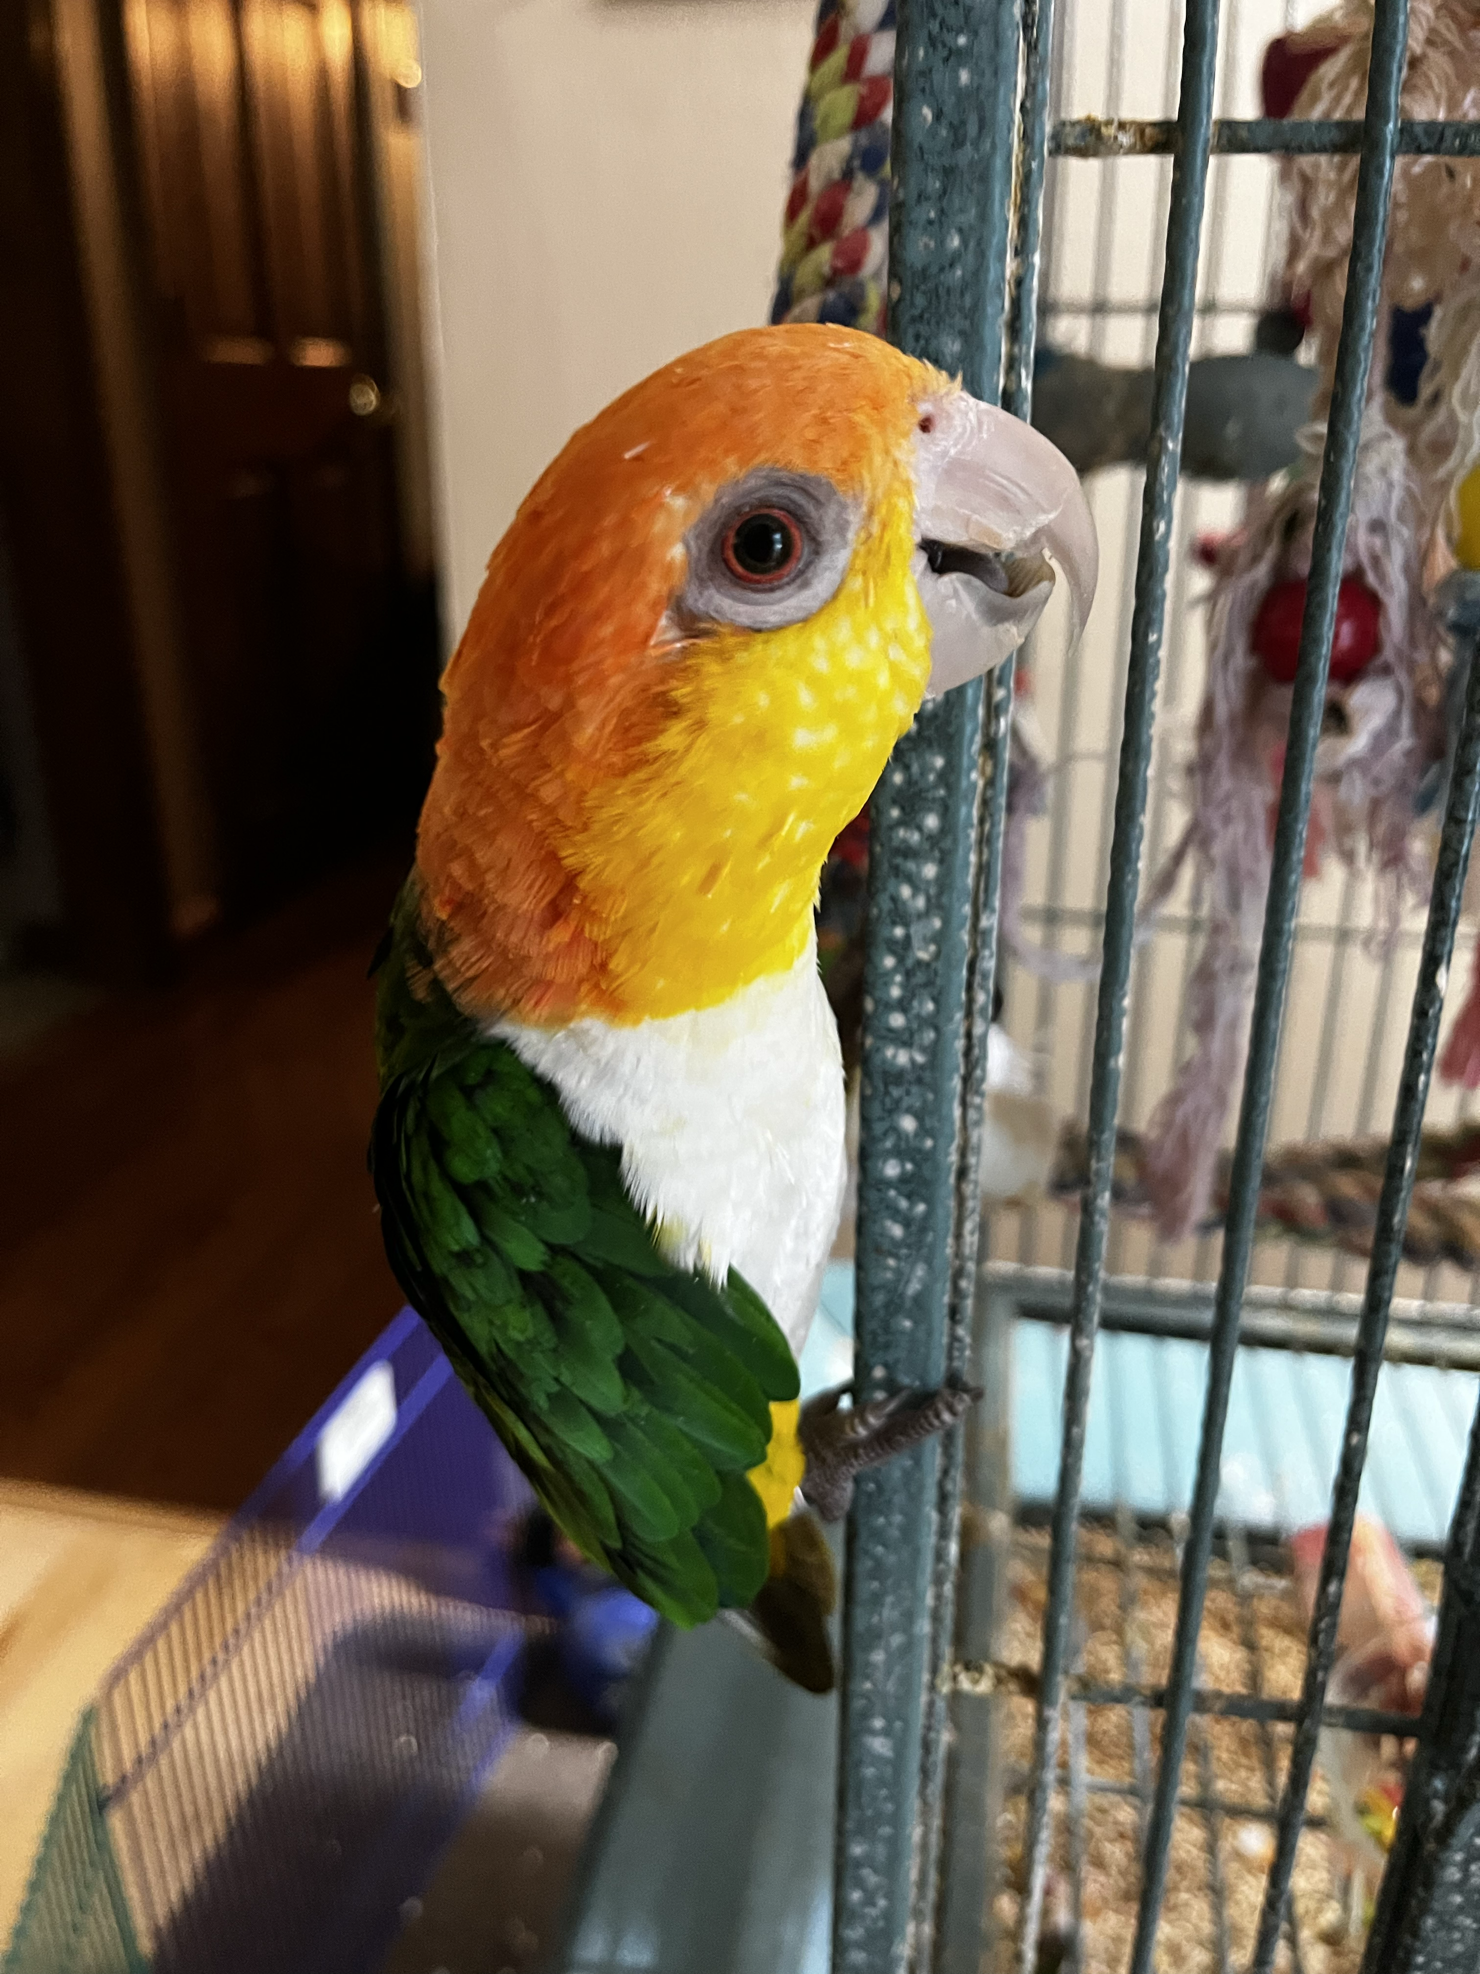
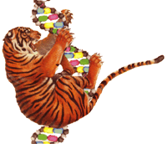

Intro to Brian Haas
Education and Career History
BS,MS Molecular Bio
DNA Repair
SUNY Albany
Cambridge, Massachusetts, USA
2007-current
The Institute for Genomic Research
Rockville, Maryland, USA
(1999-2007)
Computational Biologist / Manager / PI
1991-1999
Ph.D. Bioinformatics / Boston University
Bioinformatics Analyst & Engineer
MS. Computer Science / Johns Hopkins
Notes:
Self intro

Slide 3


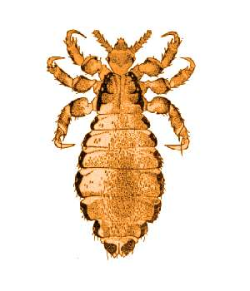
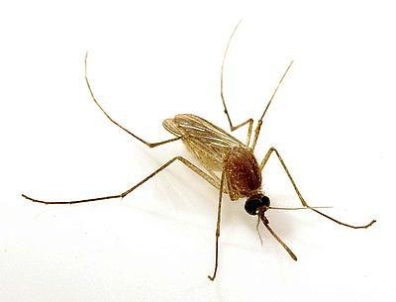


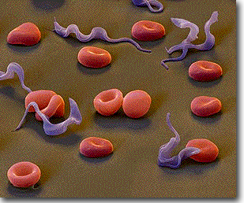
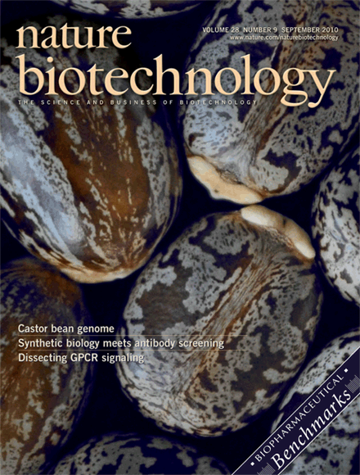
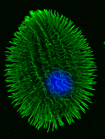

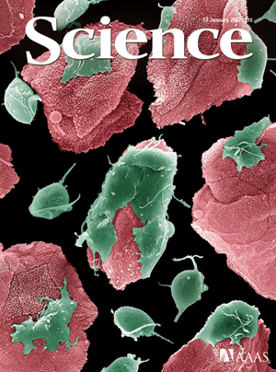
Annotation and Analysis for Diverse Genomes and Transcriptomes

Slide 4

My Favorite Activity – Bioinformatics Tool Development and Application
NAR, 2003
Chimera Slayer
Genome Research, 2011
Nature Biotech, 2011
Nature Protocols, 2013
Bioinformatics, 2004
EVidenceModeler
Genome Biology, 2008
STAR-Fusion
Genome Biology, 2019
FusionInspector
Cell Reports Methods, 2023
Notes:
At both TIGR and the Broad, many opportunities to develop software tools to facilitate genome annotation or analysis. Tools from up to 20 years ago like PASA are still being used and supported.
At the Broad, we developed the Trinity software for genome-free de novo transcriptome assembly.
In recent years, much of my attention has focused on developing tools for studying cancer transcriptomes with a focus on fusion transcript detection.
My latest tool called FusionInspector was published just yesterday.

Slide 5
My Favorite Activity – Bioinformatics Tool Development and Application
NAR, 2003
Chimera Slayer
Genome Research, 2011
Nature Biotech, 2011
Nature Protocols, 2013
Bioinformatics, 2004
EVidenceModeler
Genome Biology, 2008
STAR-Fusion
Genome Biology, 2019
FusionInspector
Cell Reports Methods, 2023
Notes:
Most of the tools I’ve worked on have focused on leveraging transcriptome sequencing data given that it’s one of the most useful data types for exploring genome biology for most forms of life.

Slide 6
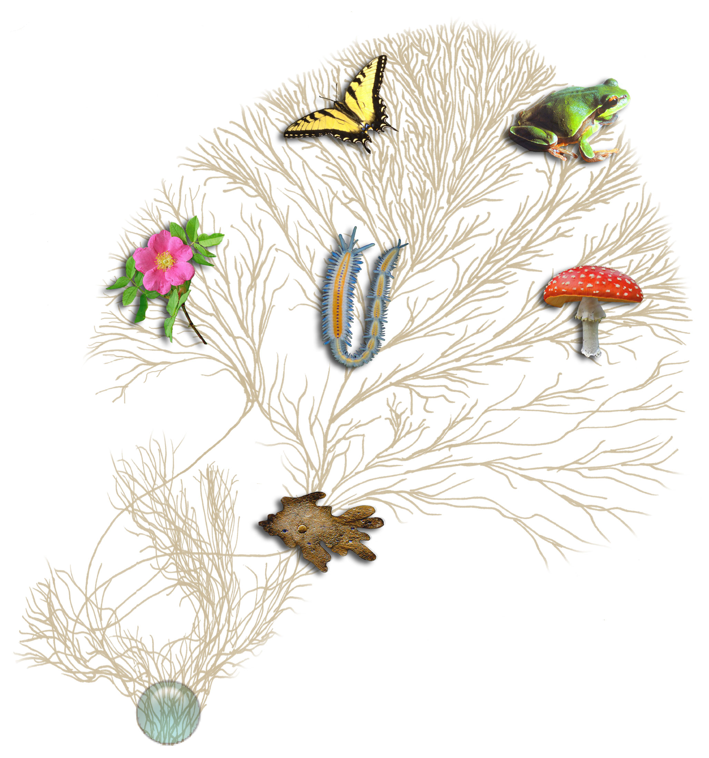
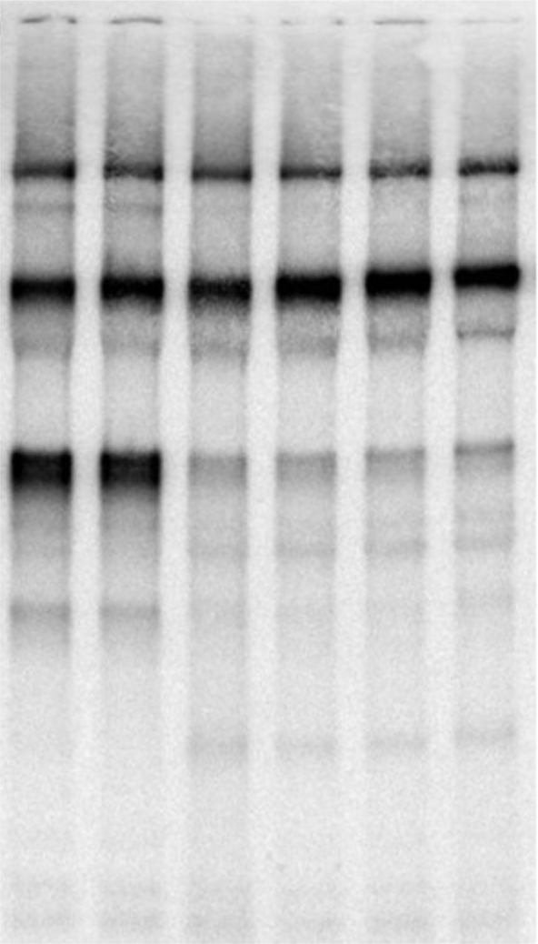
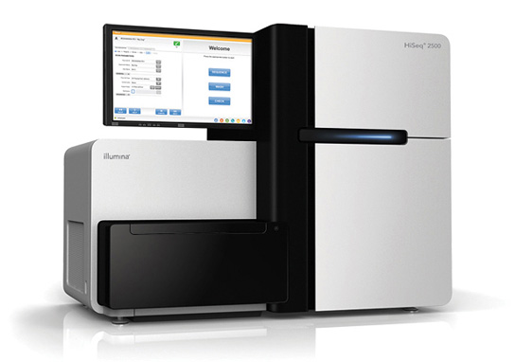
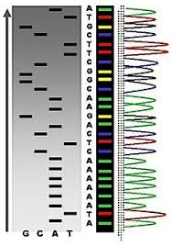
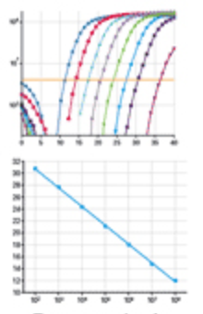
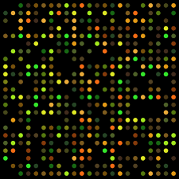
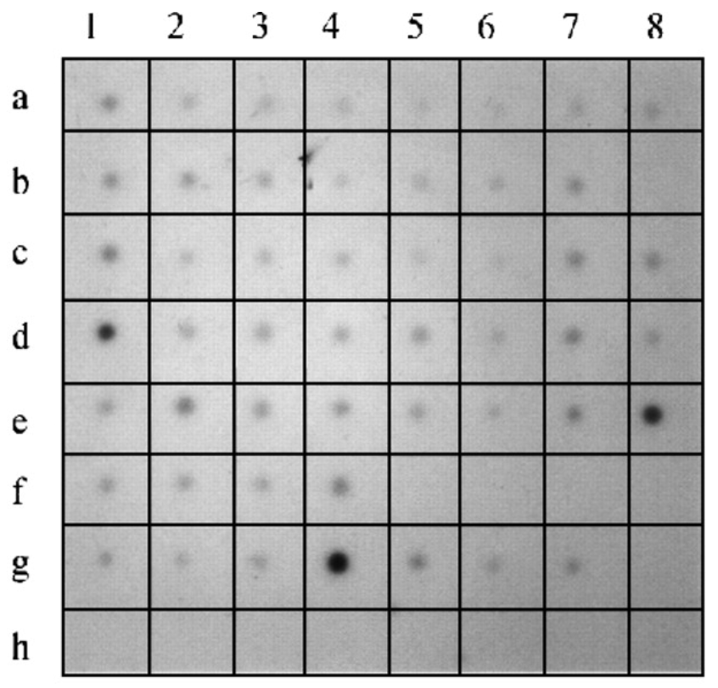
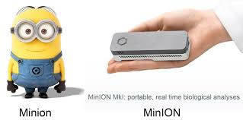
Biological Investigations Empowered by Transcriptomics
Extract RNA,
… some protocol for processing, ...
Northern
Analysis Method
(pick your favorite)
Other…
Microarray
Dot Blot
Sanger Sequencing
qRT-PCR
Notes:
Many biological investigations have been empowered by transcriptomics over the years.
Transcriptomics has historically involved extracting RNA from some living organism and then using some technology to study its various characteristics, such as quantifying expression or identifying its sequence
And the technology has changed dramatically over the years, from doing Northern blots or dot blots with radioactive isotopes to microarrays, qRT-PCR, and the various advances in sequencing.

Slide 7
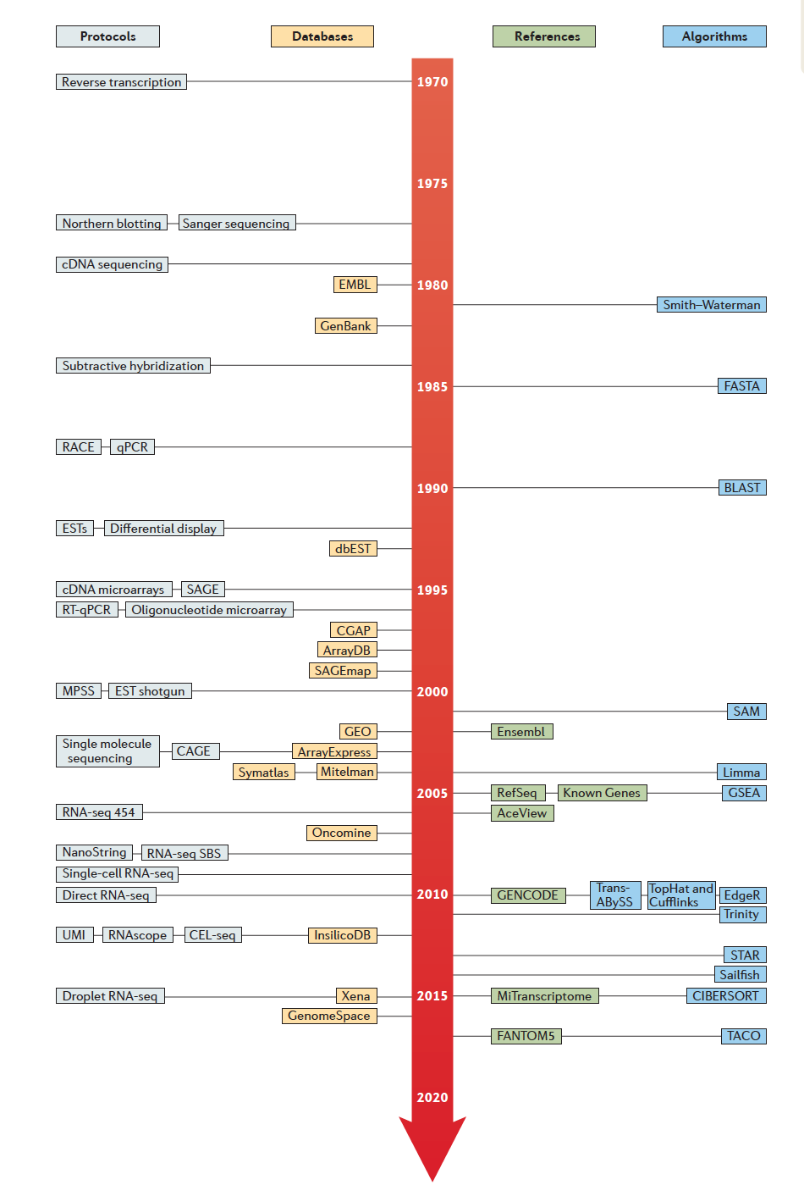
Historical Timeline to Modern Transcriptomics (from 1970)
Reverse Transcription (1970)
Note: Just a small sampling of what’s available.
Northern Blot
Sanger Sequencing
(1977)
Smith Waterman (1981)
BLAST (1990)
Expressed Sequence Tags (1992)
cDNA microarrays (1995)
SAMtools (2009)
Tophat/Cufflinks (2010)
RNA-Seq (2006-2008)
RSEM
(2011)
PacBio IsoSeq (2014)
Droplet single cell RNA-Seq (2015)
STAR (2013)
StringTie (2015)
Direct RNA Seq Nanopore (2018)
Kallisto (2016)
Salmon (2017)
SlideSeq-v2 (2021)
From Cieslik and Chinnaiyan,
NRG, 2017
minimap2 (2018)
Lots more!
Seurat-v2 (2021)
Notes:
Advances in transcriptomics spanned developments in experimental protocols, sequence databases, and algorithms for analyzing these data.
The discovery of reverse transcriptase in 1970 arguably spurred most of the modern advancements. Almost all RNA methods commonly used today leverage reverse transcriptase as part of the protocol.
Some of the key developments include EST sequencing in the early 90’s, the invention of cDNA microarrays in the mid-90’s, RNA-seq came about around 2006, long read pacbio isoseq in 2014, single cell transcriptomics, and direct RNA sequencing using nanopores.
Advances with experimental protocols and development of new sequencing data types, formats, and scale of data production have dovetailed with developments of new tools and algorithms to effectively make use of these data and facilitate data analysis and interpretation.

Slide 8
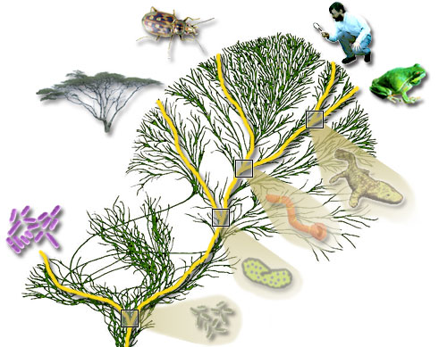
Modern Transcriptome Studies Empowered by RNA-seq
Extract RNA, convert to cDNA
Next-gen Sequencer
(pick your favorite)
Millions to Billions of Reads
Notes:
Modern transcriptome studies

Slide 9
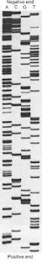
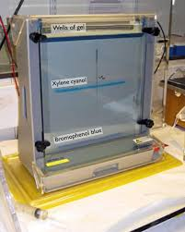
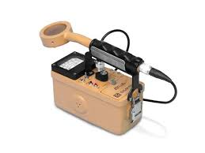
Personal Reflections...
Circa 1995

Slide 10
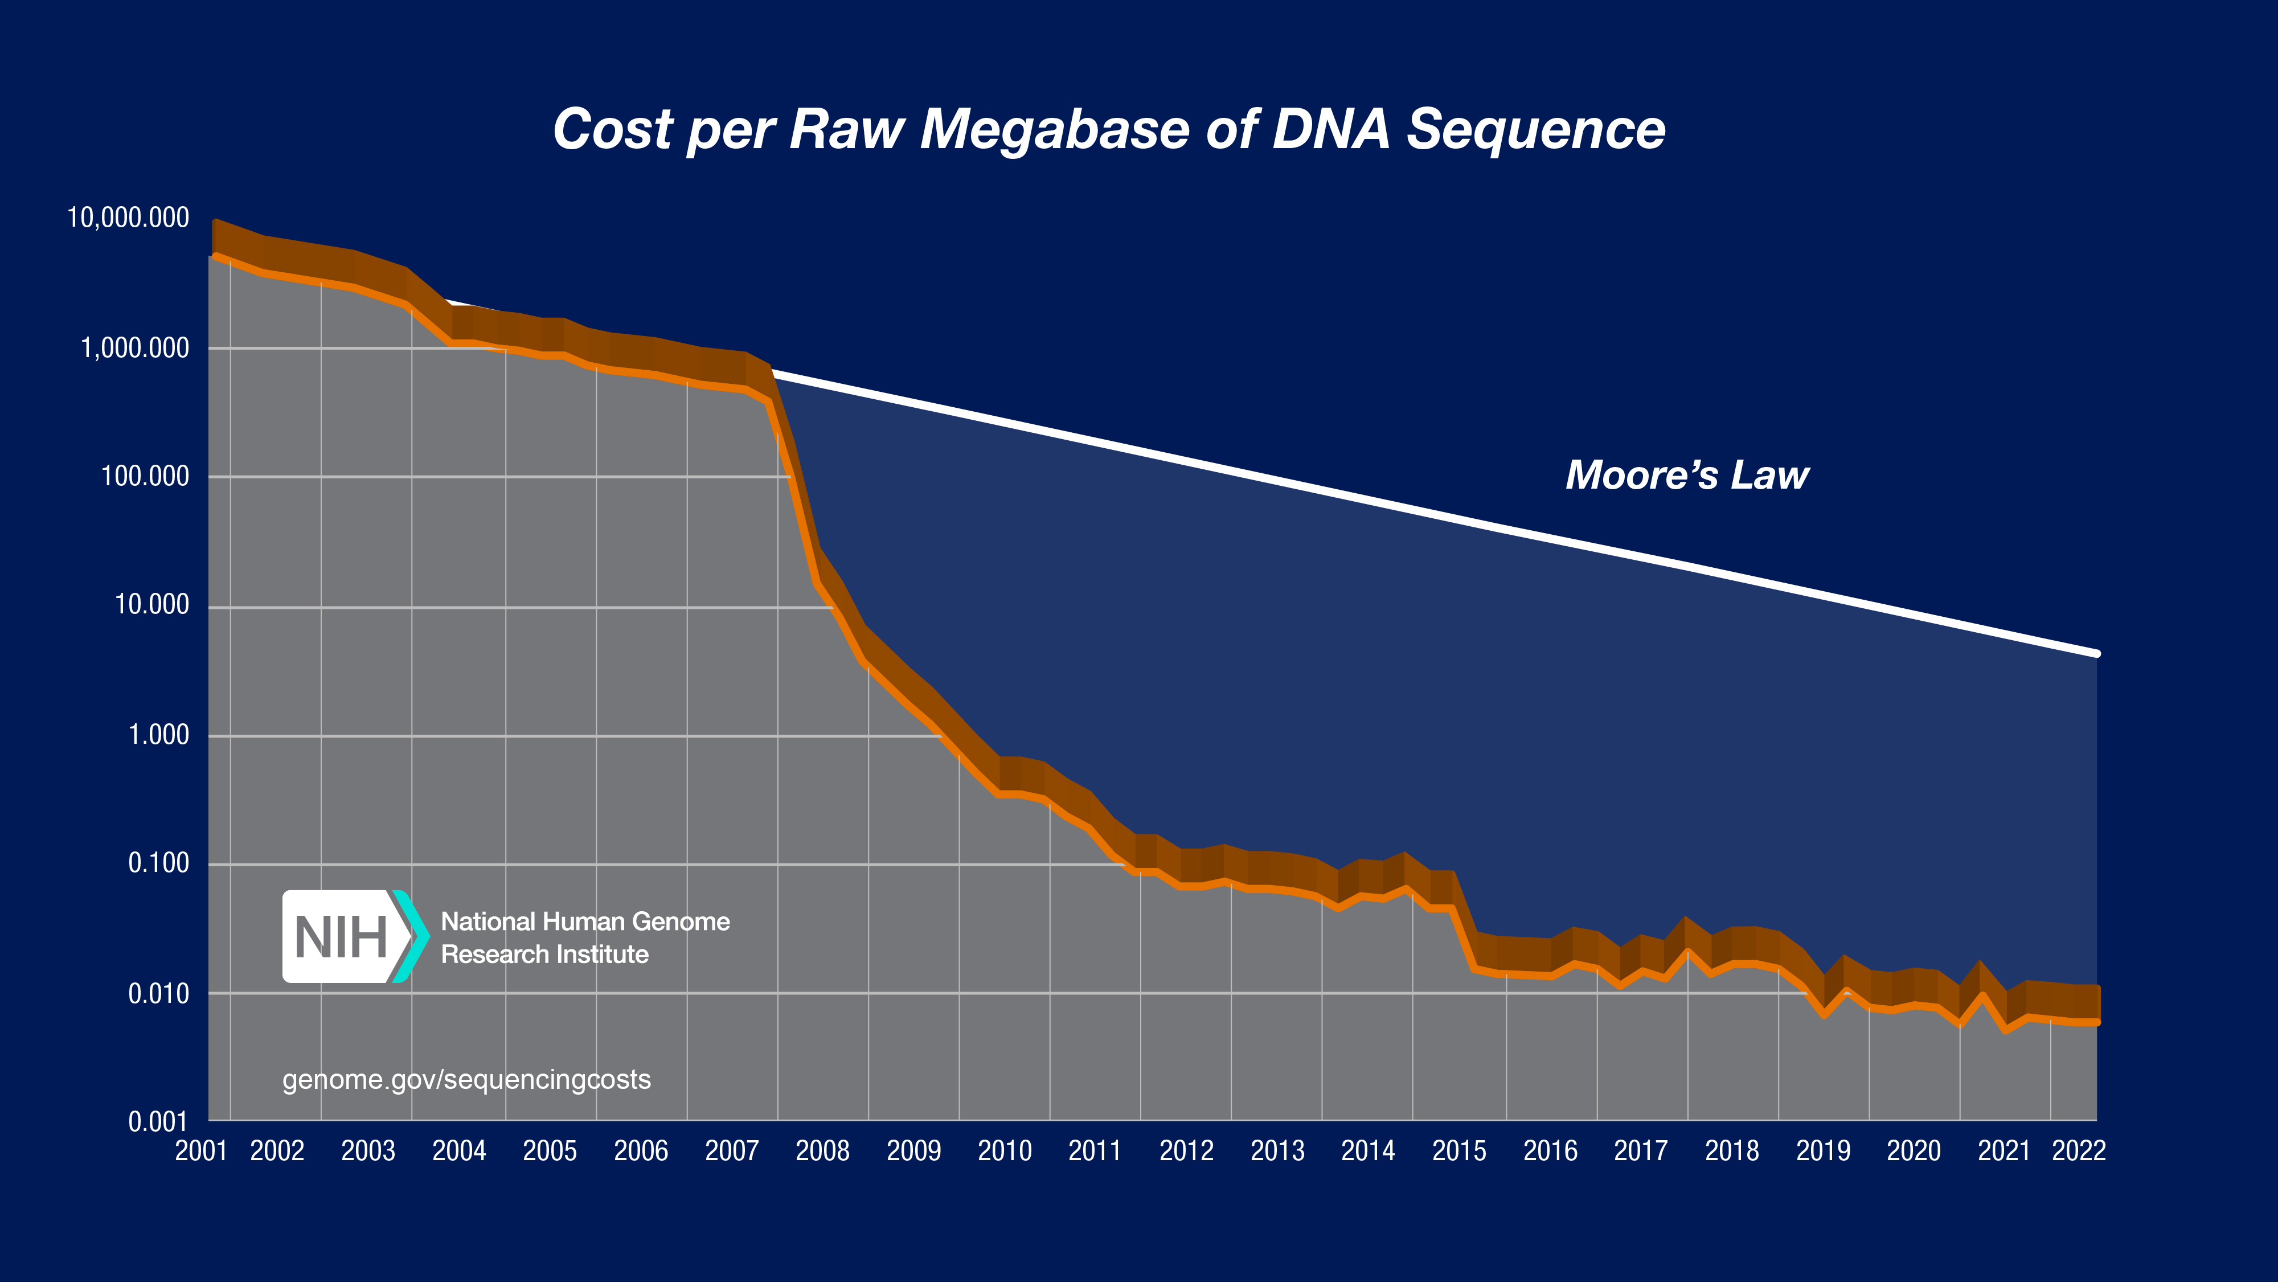
Hello Next-Gen Sequencing!
From https://www.genome.gov/about-genomics/fact-sheets/DNA-Sequencing-Costs-Data
Notes:
We’ve witnessed a technological revolution.
Routinely sequencing as an assay for biological discovery.

Slide 11
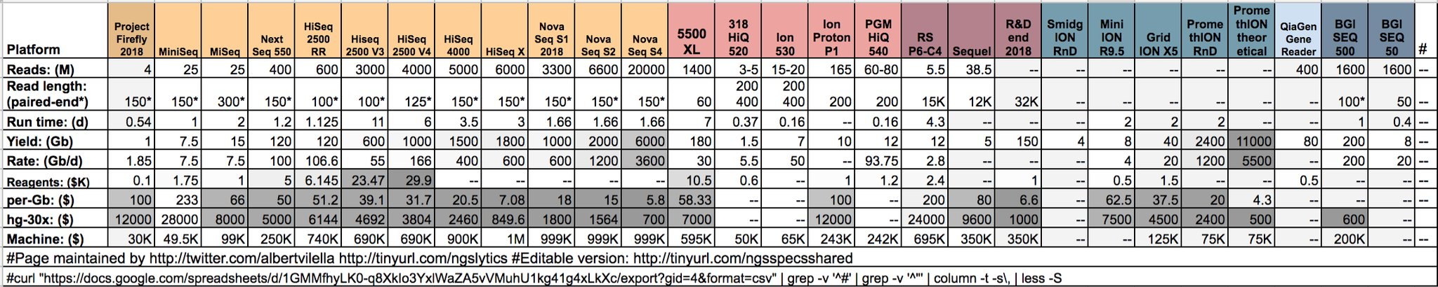
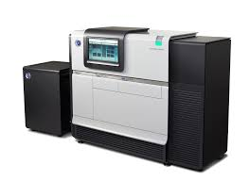
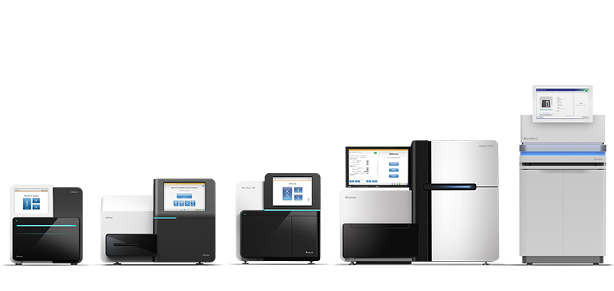
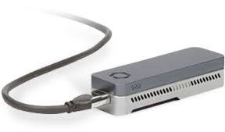
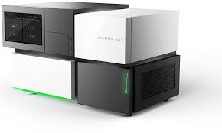
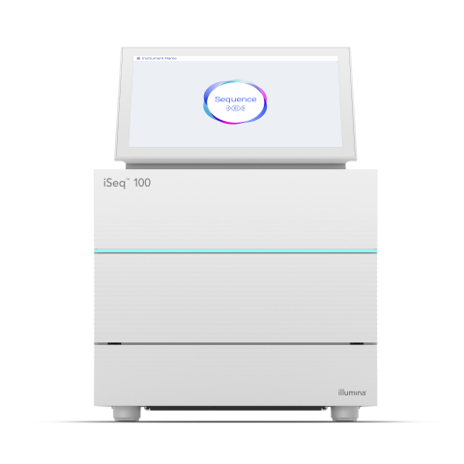
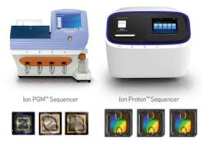
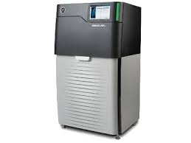
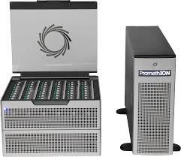
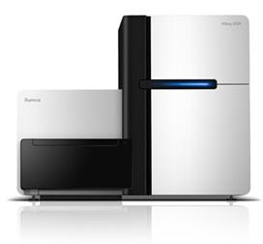
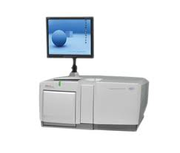
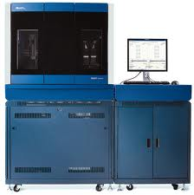
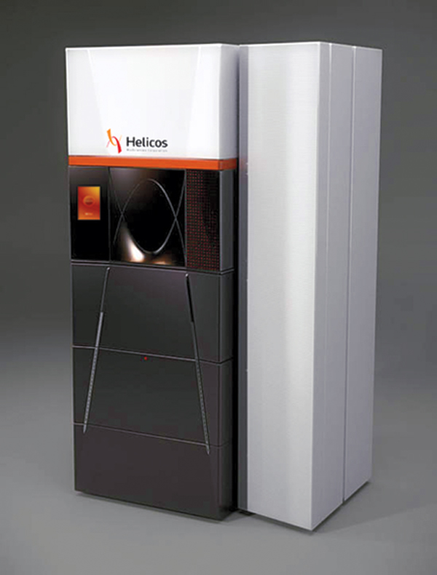
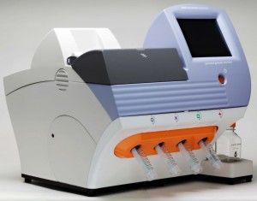
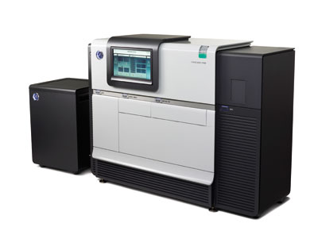
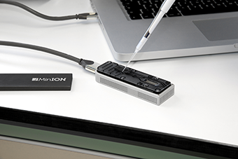
Generating RNA-Seq: How to Choose?
iSeq
Stats circa 2018
For current, see: https://tinyurl.com/wbgcs65
*Not all shown at scale
Illumina
454
SOLiD
Helicos
Ion Torrent
Pacific Biosciences
Oxford Nanopore
Slide courtesy of Joshua Levin, Broad Institute.
Notes:
The current technological landscape for sequences is somewhat diverse, although there are some clear favorites and those that are currently dominating the market.
Illumina, in particular, is one of the dominating technologies.
This here is a table that contrasts the features of the different sequencers including cost, throughput, runtimes, read lengths, etc.
Prices vary considerably according to these specs, anywhere from tens of thousands to a million dollars, and that doesn’t cover the reagent costs. Julian covered many of these last week.

Slide 12
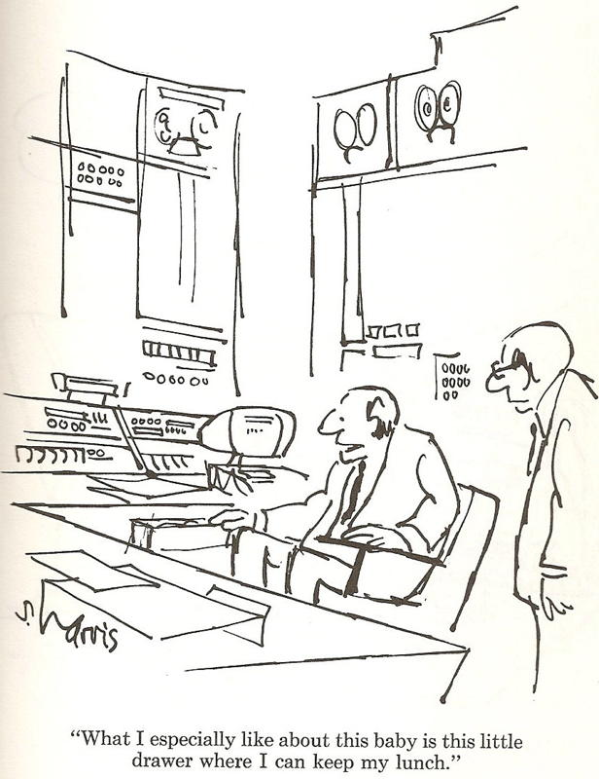
Generating RNA-Seq: How to Choose?
*Not all shown at scale
Thx Joshua Levin, for the cartoon. ☺
Illumina
454
SOLiD
Helicos
Ion Torrent
Pacific Biosciences
Oxford Nanopore
Slide courtesy of Joshua Levin, Broad Institute.
Notes:
Everyone has different reasons for choosing one.

Slide 13
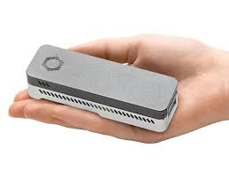
Maybe something more portable?

Slide 14
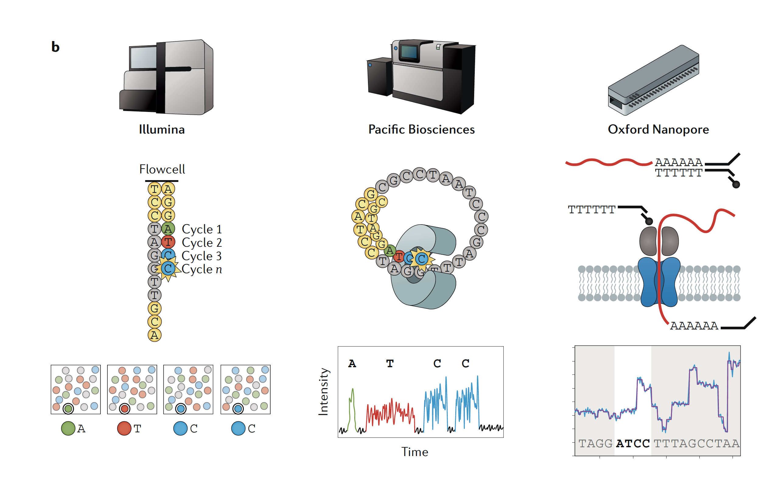
Today’s Most Popular Sequencing Technologies
Images from “RNA sequencing: the teenage years”
Rory Stark, Marta Grzelak & James Hadfield
Nature Reviews Genetics volume 20, pages631–656(2019)

Slide 15
Today’s Most Popular Sequencing Technologies
Hundreds of millions to billions of highly accurate but shorter reads.
Limited sequencing depth, but highly accurate full-length single molecule reads. ($$$)
Limited sequencing depth, and moderate-to-highly accurate full-length single molecule reads. ($$)
Images from “RNA sequencing: the teenage years”
Rory Stark, Marta Grzelak & James Hadfield
Nature Reviews Genetics volume 20, pages631–656(2019)
Video at: https://youtu.be/fCd6B5HRaZ8
Notes:
Illumina uses a ‘sequence by synthesis’ technique where fragmented sequences are separated onto a slide, and flurorophore labeled bases are flowed in cycles, one flow cycle for each nucleotide. Each of the bases has a different colored fluorophre. A laser is used to excite the fluorophore, and newly incorporated bases light up as colored spots on the slide. Image processing is used to read off the sequences that are being synthesized at each spot on the slide, one nucleotide at a time.
The original technology leveraged 4 fluorophores and 4 image analyses per cycle, with each base having a different color. Newer machines leverage a 2 color technology.

Slide 16
Today’s Most Popular Sequencing Technologies
Hundreds of millions to billions of highly accurate but shorter reads. ($)
Limited sequencing depth, but highly accurate full-length single molecule reads.
Limited sequencing depth, and moderate-to-highly accurate full-length single molecule reads. ($$)
Images from “RNA sequencing: the teenage years”
Rory Stark, Marta Grzelak & James Hadfield
Nature Reviews Genetics volume 20, pages631–656(2019)
Video at: https://www.youtube.com/watch?v=_lD8JyAbwEo
Notes:
Pac bio: Signal durations per base
Zero mode wave guide with a DNA polymerase bound at the bottom of a channel.
dNTPs are available for synthesis, each one labeled a different color, and movies are taken that watch as different bases get inserted. The different bases are not only colored differently, but also take different amounts of time to get incorporated, and from these signals, the sequence can be deciphered.

Slide 17
Today’s Most Popular Sequencing Technologies
Video: https://nanoporetech.com/how-it-works#fullVideo&modal=fullVideo
Hundreds of millions to billions of highly accurate but shorter reads. ($)
Limited sequencing depth, but highly accurate full-length single molecule reads. ($$$)
Limited sequencing depth, and moderate-to-highly accurate full-length single molecule reads.
Images from “RNA sequencing: the teenage years”
Rory Stark, Marta Grzelak & James Hadfield
Nature Reviews Genetics volume 20, pages631–656(2019)
Can do direct RNA sequencing! and find evidence for methylation
Notes:
Nanopore: 3 central nucleotides determine the signal, but adjacent bases contribute.
Disruption of current measured in signal trace.
No synthesis, but rather a motor protein pushes the sequence through a nanopore.
See paper: https://www.nature.com/articles/s41587-021-01108-x

Slide 18
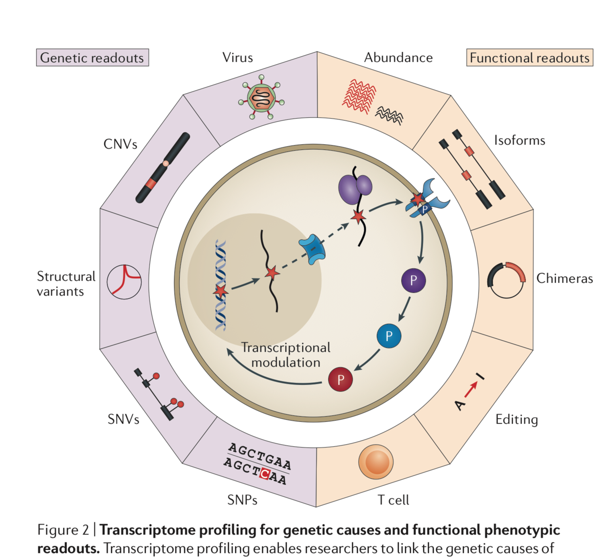
A Plethora of Biological Sequence Analyses Enabled by RNA-Seq
(ie. mutations)
From Cieslik and Chinnaiyan, NRG, 2017

Slide 19
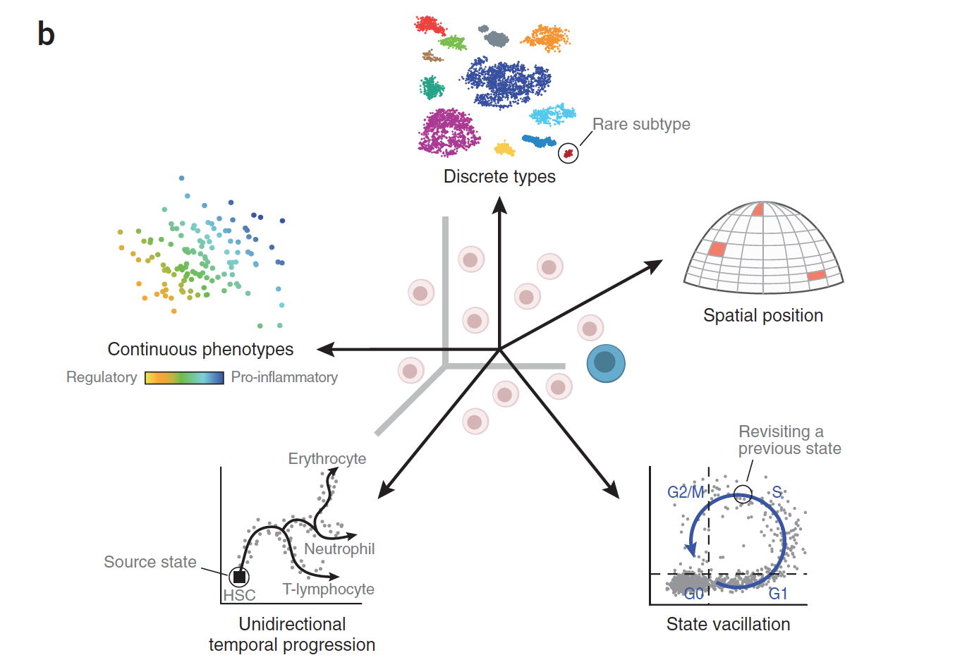
RNA-Seq is Empowering Discovery at Single Cell Resolution
Wagner, Regev, and Yosef. NBT 2016
Notes:
Primary – cell type analysis
Spatial transcriptomics
State vacillation such as cell cycling
Differentiation trajectories
And evaluating continuous phenotypes

Slide 20
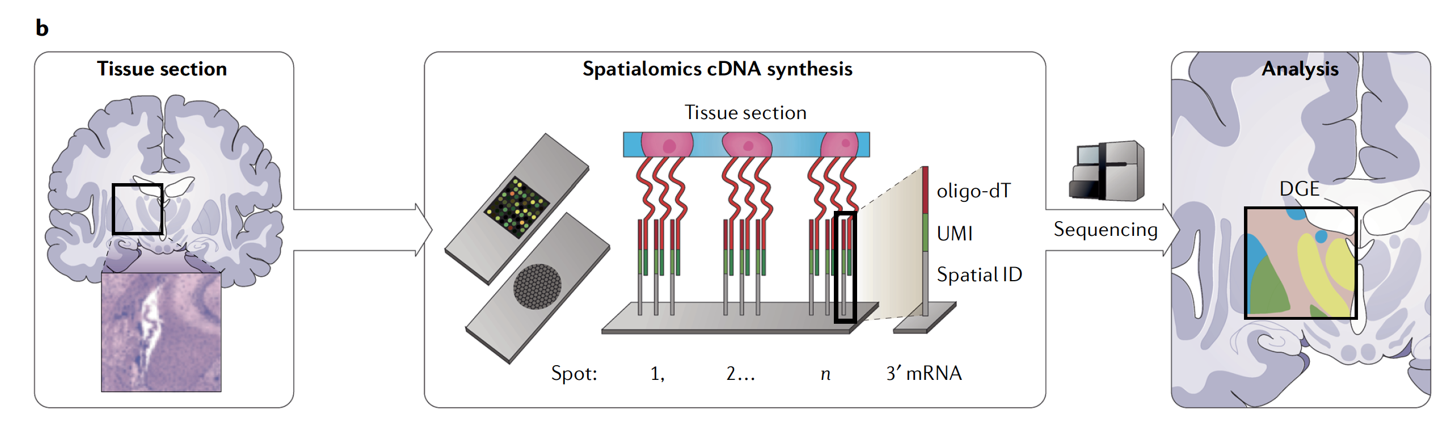
Spatial Transcriptomics
Spatial Encoding
From “RNA sequencing: the teenage years”
Rory Stark, Marta Grzelak & James Hadfield
Nature Reviews Genetics volume 20, pages631–656(2019)
Notes:
Major advances in spatial transcriptomics to explore transcriptomics at the single cell level in a spatial context.
Spatial encoding – tissue slice, affix to slide having barcoded oligos with assigned positions on the slide, do library prep on the slide, remove the amplified cDNAs containing the positional barcode info, sequence it, and then use the barcoding to in silico reconstruct the original image based on transcript expression data.

Slide 21

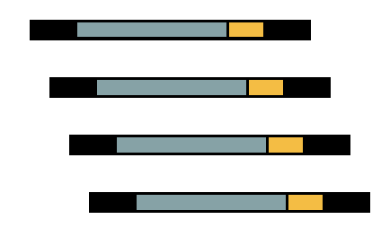
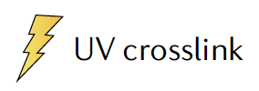


A Myriad of Other Specialized
RNA-seq -based Applications
RNA-Sequencing as your lens towards biological discovery
Adapted from “RNA sequencing: the teenage years”
Rory Stark, Marta Grzelak & James Hadfield
Nature Reviews Genetics volume 20, pages631–656(2019)
Notes:
RNA-seq can enable other biological insights / discoveries – just make RNA-sequencing your experimental assay. Capture the sequences of interest or the parts of the transcripts that matter and sequence them.

Slide 22









A Myriad of Other Specialized
RNA-seq -based Applications
RNA-RNA interactions
RNA-Protein Interactions
Ribosomal profiling
RNA Structuromics
Adapted from “RNA sequencing: the teenage years”
Rory Stark, Marta Grzelak & James Hadfield
Nature Reviews Genetics volume 20, pages631–656(2019)
Notes:
RNA-seq to enable other biological insights / discoveries – just make RNA-sequencing your experimental assay

Slide 23

RNA-seq Publication Trend
Paper Counts from PubMed
Notes:
Number of papers as a reflection of the growth of popularity in RNA-seq as a discovery tool.

Slide 24
Transcriptomics Lecture Overview
Overview of RNA-Seq
Transcript reconstruction methods
Trinity de novo assembly
Transcriptome quality assessment
Latest advances for RNA-seq
Short lab activity – running Trinity

Slide 25
Part 1. Overview of RNA-Seq

Slide 26


RNA-seq library enrichment strategies that influence interpretation and analysis.
http://journals.plos.org/ploscompbiol/article?id=10.1371/journal.pcbi.1004393
Notes:
When you initially isolate your RNA in the first step, you’re going to have a diverse collection of RNA molecules, including coding and non-coding RNAs, pre-mRNA and mature mRNAs.
Most of the RNA molecules are going to be ribosomal RNA (>90%).

Slide 27
RNA-seq library enrichment strategies that influence interpretation and analysis.
http://journals.plos.org/ploscompbiol/article?id=10.1371/journal.pcbi.1004393
Notes:
If you decide to just sequence everything, nearly all your reads are going to correspond to rRNA, and so overall information content of your sequencing data is going to be very low – and spending lots of $$ on just sequencing the same molecule over and over.

Slide 28
RNA-seq library enrichment strategies that influence interpretation and analysis.
http://journals.plos.org/ploscompbiol/article?id=10.1371/journal.pcbi.1004393
Notes:
If you really want to sequence total RNA but avoid just sequencing rRNA over and over again, there are various depletion strategies available, including commercially available kits (ie. ribozero).
These strategies can be highly effective but note there are caveats with sequencing total RNA – in addition to capturing coding transcripts, you’ll sequence a lot of noncoding RNA and partially spliced or unprocessed immature RNA molecules.

Slide 29
RNA-seq library enrichment strategies that influence interpretation and analysis.
http://journals.plos.org/ploscompbiol/article?id=10.1371/journal.pcbi.1004393
Notes:
If you know ahead of time what transcripts you want to survey, you could design capture probes and aim to capture just those transcripts of interest. This would be a lot like current exome sequencing strategies but applied to transcriptomes.
Often, though, you’ll likely be more interested in doing a less biased and more comprehensive survey, particularly if you’re not working with a well studied model organism.

Slide 30
RNA-seq library enrichment strategies that influence interpretation and analysis.
http://journals.plos.org/ploscompbiol/article?id=10.1371/journal.pcbi.1004393
Notes:
The most popular method is to focus on sequencing coding RNAs or messenger RNAs, which differ from most other RNA molecules in that they have a poly-A tail. This polyA-tail can be captured to pull out and sequence only those RNAs of interest.
The caveat here is that you must have high quality RNA for this to work well. If the RNA is heavily degraded, then you’ll only be capturing the very 3’ end of each degraded transcript, and so one of the other alternative strategies would be more appropriate in those circumstances.

Slide 31
Part 2. Transcript Reconstruction Methods

Slide 32

RNA-Seq Challenge: Transcript Reconstruction
(Avg. ~ 2 kb)
(Avg. ~ 300 b)
Reconstruct original full-length transcripts
(~ 75 to 150 b reads, SE or PE)
Adapted from: http://www2.fml.tuebingen.mpg.de/raetsch/members/research/transcriptomics.html
Notes:
In any case, the transcriptome reads that are generated from sequencing are often much shorter than the original transcript molecules they were derived from, and one of the key bioinformatic challenges is to reconstruct the original full length transcript from the shorter sequencing reads.

Slide 33

Transcript Reconstruction from RNA-Seq Reads
Notes:
One of the primary goals in RNA-Seq studies is to reconstruct the transcripts from which the short reads were derived, and transcript reconstruction is often a prerequisite to downstream studies such as genome annotation or diifferential expression analysis.
Two general strategies have been explored for reconstructing transcripts from RNA-Seq reads.

Slide 34
Transcript Reconstruction from RNA-Seq Reads
Notes:
One strategy requires having a reference genome and involves first aligning reads to the genome using a spliced aligner.

Slide 35
Transcript Reconstruction from RNA-Seq Reads
Notes:
Then, the alignments, instead of the original reads, are assembled into transcript structures.

Slide 36
Transcript Reconstruction from RNA-Seq Reads
STAR
Trinity
StringTie
GMAP
Notes:
Then, if a genome sequence is available, the assembled transcripts can be aligned to the genome to reveal individual introns and exons.

Slide 37
Transcript Reconstruction from RNA-Seq Reads
STAR
Trinity
Non-model organisms:
“I don’t have a reference genome!”
StringTie
GMAP
Notes:
Then, if a genome sequence is available, the assembled transcripts can be aligned to the genome to reveal individual introns and exons.

Slide 38
Transcript Reconstruction from RNA-Seq Reads
TopHat
Cufflinks
Notes:
An alternative strategy doesn’t require a reference genome and involves assembling the read sequences directly.

Slide 39
Transcript Reconstruction from RNA-Seq Reads
TopHat
Cufflinks
Notes:
Then, if a genome sequence is available, the assembled transcripts can be aligned to the genome to reveal individual introns and exons.

Slide 40


Transcript Reconstruction from RNA-Seq Reads
End-to-end Transcriptome-based RNA-Seq Analysis Software Package
Trinity
GMAP
Notes:
Trinity is a software tool that I helped develop, and which we published last year in Nature Biotechnology.
In this talk, I’ll describe how Trinity works, and describe some of the applications that we aim to support.

Slide 41
Transcript Reconstruction from RNA-Seq Reads
Many tools to choose among:
Trinity
Oases
SoapDenovoTrans
AbyssTrans
IDBA-Tran
Shannon
BinPacker
Bridger
…
TopHat STAR HISAT2
GSNAP
…
GMAP
BLAT
AAT
Spidey
Sim4
…
Cufflinks
Stringtie
IsoLasso
Bayesembler
Trip
Traph
CEM
TransComb
Scallop
…
Notes:
Since the advent of RNA-Seq about a decade ago, there has been great progress in the development of bioinformatics tools for performing all of these operations, supporting both genome-guided and genome-free transcriptome reconstruction and analysis.
In the next series of slides, I’ll describe the basic computational algorithms used for transcript reconstruction.

Slide 42
Transcript Reconstruction from RNA-Seq Reads
Many tools to choose among:
Trinity
Oases
SoapDenovoTrans
AbyssTrans
IDBA-Tran
Shannon
BinPacker
Bridger
…
TopHat STAR HISAT2
GSNAP
…
How does it work?
GMAP
BLAT
AAT
Spidey
Sim4
…
Cufflinks
Stringtie
IsoLasso
Bayesembler
Trip
Traph
CEM
TransComb
Scallop
…
Notes:
Since the advent of RNA-Seq about a decade ago, there has been great progress in the development of bioinformatics tools for performing all of these operations, supporting both genome-guided and genome-free transcriptome reconstruction and analysis.
In the next series of slides, I’ll describe the basic computational algorithms used for transcript reconstruction.

Slide 43
Graph Data Structures Commonly Used For Assembly
Sequence
Order
Orientation (+, -)
Overlap
Reads to Graph
GTC
AGTCA
GATC
CG
GATTACA
CGATCA
AGC
Nodes = sequence (+/-)
Edges = order, overlap
Notes:
Both the genome-guided and genome-free transcript reconstruction approaches share some common algorithmic techniques.
----
A general features of these algorithms is to encode read sequences, read order, orientation, and overlap information
---
into a directed graph structure, with oriented sequences represented by nodes, and directed edges indicating overlap and orientation.

Slide 44
Graph Data Structures Commonly Used For Assembly
Sequence
Order
Orientation (+, -)
Overlap
Reads to Graph
GTC
AGTCA
GATC
CG
GATTACA
CGATCA
AGC
GATCGTCCGAGCGATTACA
Nodes = sequence (+/-)
Edges = order, overlap
Notes:
Full length transcripts are then reconstructed by traversing a directed path in the graph, guided by characteristics of the original reads including mate-pair constraints.
If there are multiple well-supported paths through this graph, then this would be considered evidence for alternative splicing.

Slide 45

Genome-Guided Transcript Reconstruction
Splice-align reads to the genome
From Martin & Wang. Nature Reviews in Genetics. 2011
Notes:
In the case of genome-guided transcript reconstruction, the reads are aligned to the genome instead of being aligning to each other, and so we don’t encounter this scalability problem.
Here, the genome provides a scaffold by which the reads are ordered, oriented, and their overlaps are readily defined according to genomic location.
Here’s an example of a region of the genome where RNA-Seq reads were aligned…

Slide 46
Genome-Guided Transcript Reconstruction
Splice-align reads to the genome
Alignment segment piles => exon regions
From Martin & Wang. Nature Reviews in Genetics. 2011
Notes:
and we see stacks of reads piling up at locations throughout this locus.
The piles of alignment segments provide evidence of exons

Slide 47
Genome-Guided Transcript Reconstruction
Splice-align reads to the genome
Large alignment gaps => introns
From Martin & Wang. Nature Reviews in Genetics. 2011
Notes:
And the large gaps between alignment segments provide evidence of introns that were spliced out in the mature transcript.

Slide 48
Genome-Guided Transcript Reconstruction
Splice-align reads to the genome
Overlapping but different introns = evidence of alternative splicing
From Martin & Wang. Nature Reviews in Genetics. 2011
Notes:
In some cases, candidate introns are found to overlap but have different end points, and this provides evidence of alternative splicing.

Slide 49
Genome-Guided Transcript Reconstruction
Splice-align reads to the genome
From Martin & Wang. Nature Reviews in Genetics. 2011
Notes:
As discussed earlier, in order to assemble transcripts we’re going to encode the RNA-Seq data into a directed graph.
Based on the RNA-Seq read alignments, we were able to identify the individual exon and intron components of the gene expressed at this locus.

Slide 50
Genome-Guided Transcript Reconstruction
Splice-align reads to the genome
Individual reads can yield multiple exon and intron segments (splice patterns)
From Martin & Wang. Nature Reviews in Genetics. 2011
Notes:
If we look carefully, we can find examples of individual reads aligning to the genome and providing evidence for multiple introns and exons, and so we know that those introns and exons should be connected in the final transcript reconstructions.

Slide 51

Genome-Guided Transcript Reconstruction
Splice-align reads to the genome
Nodes = unique splice patterns
From Martin & Wang. Nature Reviews in Genetics. 2011
Notes:
We can identify all such unique splice patterns provided by the reads, and start building our graph using the splice patterns as nodes.

Slide 52

Genome-Guided Transcript Reconstruction
Splice-align reads to the genome
Construct graph from unique splice patterns of aligned reads.
Nodes = unique splice patterns
From Martin & Wang. Nature Reviews in Genetics. 2011
Notes:
We do this for all unique splice patterns. Here, the number of splice patterns is just a small fraction of the total number of aligned reads, and so we have a relatively few number of nodes to work with in our graph.

Slide 53
Genome-Guided Transcript Reconstruction
Splice-align reads to the genome
Construct graph from unique splice patterns of aligned reads.
Nodes = unique splice patterns
Edges = compatible patterns
From Martin & Wang. Nature Reviews in Genetics. 2011
Notes:
We then incorporate edges into the graph, drawing an edge between splice patterns that overlap and are compatible, that is to say that they could have come from the same transcript isoform. These are all cases where the splice patterns overlap and if there are introns in the overlapping region, those introns have identical splice sites.
For example, these top two alignment patterns overlap and they don’t conflict in their region of overlap. They could have come from the same transcript isoform, and so we can draw an edge between them.
----
Similarly, this splicing pattern demonstrates overlap, and the overlapping introns have identical splice sites, so these are deemed compatible, possibly deriving from the same transcript isoform, and we draw an edge between them.
----
We do this for all overlapping splice patterns.

Slide 54
Genome-Guided Transcript Reconstruction
Splice-align reads to the genome
Construct graph from unique splice patterns of aligned reads.
Nodes = unique splice patterns
Edges = compatible patterns
From Martin & Wang. Nature Reviews in Genetics. 2011
Notes:
Here we have those splice patterns that overlap but have different introns, and these could not have come from the same transcript, so we cannot draw an edge between them in our graph.

Slide 55

Genome-Guided Transcript Reconstruction
Traverse paths through the graph to assemble transcript isoforms
From Martin & Wang. Nature Reviews in Genetics. 2011
Notes:
Once we’ve completed our graph, we can then traverse paths through the graph to reconstruct candidate isoforms.
Here, we’ve outlined 4 possible paths…

Slide 56

Genome-Guided Transcript Reconstruction
Traverse paths through the graph to assemble transcript isoforms
Reconstructed isoforms
From Martin & Wang. Nature Reviews in Genetics. 2011
Notes:
And tracing each path yields a different transcript structure.
There are a large number of variations of this technique, and it usually involves scoring the possible paths according to some objective function, and only reporting those candidate isoform reconstructions that are best supported by the read alignments.

Slide 57
What if you don’t have a high quality reference genome sequence?
Genome-free de novo transcript reconstruction to the rescue.

Slide 58
Read Overlap Graph: Reads as nodes, overlaps as edges
Notes:
One way to build such a graph is treat each read as a separate node, and to perform all combinations of pairwise alignments between reads in order to identify overlaps and extensions.

Slide 59
Read Overlap Graph: Reads as nodes, overlaps as edges
Node = read
Edge = overlap
Notes:
From the overlap information, we would build an overlap graph with reads as nodes and overlaps as edges.

Slide 60
Read Overlap Graph: Reads as nodes, overlaps as edges
Transcript A
Generate consensus sequence where reads overlap
Node = read
Edge = overlap
Transcript B
Notes:
One could then trace the path of overlap extensions to assemble the longer sequence
----
If there are minor sequence differences in the regions of overlap that are likely due to sequencing error, these could be corrected by just taking a consensus and taking any original read quality information into account.

Slide 61

Finding pairwise overlaps between n reads involves ~ n² comparisons.
Impractical for typical RNA-Seq data (50M reads)
Notes:
This approach can be highly effective, but it simply doesn’t scale well for large data sets such as those generated using RNA-Seq.
Building the overlap graph involved aligning and comparing each read to every other read. If we have ‘n’ reads, then this would involve roughly n^2 number of comparisons.
----
If we plot the number of pairwise alignments required as a function of the number of reads, we see that the number of alignments grows exponentially.
----
This is a problem because it means that the amount of time it would take to do the alignments as well as the amount of computer hardware required to store the information would also grow exponentially, and so it’s just not a viable approach for assembling the many millions or billions of reads generated in an RNA-Seq experiment.

Slide 62
No genome to align to… De novo assembly required
Want to avoid n² read alignments to define overlaps
Use a de Bruijn graph
Have you learned about the de Bruijn graph already?
Notes:
If we don’t have a genome to align to, we need to be able to assemble the reads directly, but we need a way to avoid doing all pairwise alignments between the reads.
----
A popular technique for doing de novo assembly of short reads is to leverage a de Bruijn graph data structure. The de Bruijn graph was initially applied to genome assembly and was later adopted for transcriptome assembly. There are some key differences between assembling genomes and assembling transcriptomes using de Bruijn graphs, and I’ll comment more on that shortly.

Slide 63

Sequence Assembly via de Bruijn Graphs
Generate all substrings of length k from the reads
k-mers (k=5)
Reads
From Martin & Wang, Nat. Rev. Genet. 2011
Notes:
A de Bruijn graph represents connectivity between sequences observed within reads, and the overlaps between reads are apparent by the virtue of having shared substrings.
The first step in a de Bruijn graph-based assembly is to construct the de Bruijn graph from the sequence reads.
Each read is decomposed into substrings of some specified length k. Each word of length k is called a k-mer. In this example, k is set to 5, so here each 5-mer is extracted from the read.
----
An ordered list of k-mers is generated by scanning a window of length k across the length of the read.

Slide 64
Sequence Assembly via De Bruijn Graphs
Generate all substrings of length k from the reads
k-mers (k=5)
Reads
From Martin & Wang, Nat. Rev. Genet. 2011
Notes:
That kmer is extracted from the read sequence

Slide 65

Sequence Assembly via De Bruijn Graphs
Generate all substrings of length k from the reads
k-mers (k=5)
Reads
Construct the de Bruijn graph
Nodes = unique k-mers
From Martin & Wang, Nat. Rev. Genet. 2011
Notes:
and inserted as a node in our de Bruijn graph. This graph node now represents this unique kmer sequence, and this single node will represent this unique kmer for every occurrence of this kmer in the entire set of reads.

Slide 66
Sequence Assembly via De Bruijn Graphs
Generate all substrings of length k from the reads
k-mers (k=5)
Reads
Construct the de Bruijn graph
Nodes = unique k-mers
Edges = overlap by (k-1)
From Martin & Wang, Nat. Rev. Genet. 2011
Notes:
We then shift the window over by one base, extract that k-mer…

Slide 67
Sequence Assembly via De Bruijn Graphs
Generate all substrings of length k from the reads
k-mers (k=5)
(k-1) overlap
Reads
Construct the de Bruijn graph
Nodes = unique k-mers
Edges = overlap by (k-1)
From Martin & Wang, Nat. Rev. Genet. 2011
Notes:
and insert it as another node in our de Bruijn graph.

Slide 68
Sequence Assembly via De Bruijn Graphs
Generate all substrings of length k from the reads
k-mers (k=5)
(k-1) overlap
Reads
Construct the de Bruijn graph
Nodes = unique k-mers
Edges = overlap by (k-1)
From Martin & Wang, Nat. Rev. Genet. 2011
Notes:
For each pair of neighboring k-mers, which overlap by k-1 bases, we include an edge between them in the graph.

Slide 69
Sequence Assembly via De Bruijn Graphs
Generate all substrings of length k from the reads
k-mers (k=5)
Reads
Construct the de Bruijn graph
Nodes = unique k-mers
Edges = overlap by (k-1)
From Martin & Wang, Nat. Rev. Genet. 2011
Notes:
We continue to do this for all reads and fully construct our de Bruijn graph.
This de Bruijn graph is a very effective and compact way of representing the sequence data within the reads. For example, hundreds of millions of reads can be sequenced, and the identical sequence regions within reads become compressed into individual nodes within the graph.
At positions where related sequences diverge due to allelic polymorphisms, splicing variations, repeats, or due to sequencing errors, the graph will branch and can form bulges or loops.

Slide 70

Construct the de Bruijn graph
Collapse the de Bruijn graph
From Martin & Wang, Nat. Rev. Genet. 2011
Notes:
After building the graph from all the reads, the graph is typically pruned to remove bubbles and structures that likely stem from sequencing errors,
and the graph is further simplified by collapsing those nodes that form linear unbranched chains of overlapping k-mers.
--
For example, this linear chain of kmers is compressed into a single node in the compacted graph.

Slide 71


Collapse the de Bruijn graph
Traverse the graph
Assemble Transcript Isoforms
From Martin & Wang, Nat. Rev. Genet. 2011
Notes:
Now, to reconstruct transcripts, we define paths in the graph that are supported by the reads, and traverse those paths to reconstruct complete isoform sequences.
--
In this example, there are again four possible paths from the beginning to the end of the graph, each path shown traced by a different color.
By traversing each path, a different transcript sequence is generated.
--
Again, there are many different algorithms and techniques for defining best paths within this graph, and ideally the best paths reported are those that are best supported by the RNA-Seq data, taking into account the paths supported by individual read sequences and any mate-pairing information that may be available.

Slide 72
Part 3. Trinity De novo Assembly

Slide 73

Contrasting Genome and Transcriptome Assembly
Genome Assembly
Transcriptome Assembly
Uniform coverage
Single contig per locus
Double-stranded
Exponentially distributed coverage levels
Multiple contigs per locus (alt splicing)
Strand-specific
Notes:
Both genome and transcriptome assemblers leverage the de Bruijn graph structure, but are tuned to assemble reads according to very different expected characteristics. This is why you wouldn’t want to leverage a genome assembler for transcriptome assembly and vice-versa, since each method is highly specialized.
Some of the key differences between genome and transcriptome assemblers include the following:
--
Genome assemblers expect that read coverage is going to be rather uniform and will often discard sequences that occur at high coverage as repetitive sequences. Transcriptome assembly needs to consider a wide range of coverage levels spanning several orders of magnitude since sequences with high coverage are more likely to represent highly expressed transcripts instead of repeats.
--
Genome assemblers aim to generate a single contig per locus, possibly two if tuned to separate haplotypes in a polymorphic genome assembly. In transcriptome assembly, it’s understood that single genes can generate many alternatively spliced transcripts, and multiple contigs are reported per locus where evidence of transcript complexity exists.
--
Finally, in genome assembly, reads are assumed to be derived from either strand of the double-stranded DNA molecule. Given strand-specific RNA-Seq reads, Transcriptome assemblers should aim to assemble sense and antisense transcripts separately.
--
Trinity, of course, was developed to take all of these properties into account.

Slide 74
Trinity Aggregates Isolated Transcript Graphs
Genome Assembly
Single Massive Graph
Trinity Transcriptome Assembly
Many Thousands of Small Graphs
Entire chromosomes represented.
Ideally, one graph per expressed gene.
Notes:
A significant difference between Trinity as compared to all other assemblers is how it goes about building the graphs.
Genome assemblers (and other transcriptome assemblers that are built on top of genome assemblers) typically build single large graphs.
Trinity instead tries to partition the data into many thousands of small graphs, ideally one graph per expressed gene. This is possible because most expressed transcripts tend to be non-overlapping.
Having many small graphs lends itself to massive parallel processing, which is an added computational benefit.

Slide 75




Trinity – How it works:
RNA-Seq reads
Linear
contigs
de-Bruijn
graphs
Transcripts
+
Isoforms
Thousands of disjoint graphs
Notes:
Here’s a high-level overview of the whole Trinity assembly algorithm.
We call it Trinity because it involves three major steps that we’ve built into three separate software modules.
It starts with Inchworm, which first assembles the RNA-Seq data into linear contigs.
Then, Chrysalis groups contigs that are related due to alternative splicing or gene duplication and constructs de bruijn graphs.
Finally, Butterfly examines reads in the context of the de bruijn graphs, and reports the final full-length transcripts and isoforms of transcripts.

Slide 76
Trinity – How it works:
Younger me
Manfred Grabherr
Moran Yassour
RNA-Seq reads
Linear
contigs
de-Bruijn
graphs
Transcripts
+
Isoforms
Thousands of disjoint graphs
Notes:
Here’s a high-level overview of the whole Trinity assembly algorithm.
We call it Trinity because it involves three major steps that we’ve built into three separate software modules.
It starts with Inchworm, which first assembles the RNA-Seq data into linear contigs.
Then, Chrysalis groups contigs that are related due to alternative splicing or gene duplication and constructs de bruijn graphs.
Finally, Butterfly examines reads in the context of the de bruijn graphs, and reports the final full-length transcripts and isoforms of transcripts.

Slide 77
Trinity – How it works:
RNA-Seq reads
Linear
contigs
de-Bruijn
graphs
Transcripts
+
Isoforms
Thousands of disjoint graphs
Notes:
Here’s a high-level overview of the whole Trinity assembly algorithm.
We call it Trinity because it involves three major steps that we’ve built into three separate software modules.
It starts with Inchworm, which first assembles the RNA-Seq data into linear contigs.
Then, Chrysalis groups contigs that are related due to alternative splicing or gene duplication and constructs de bruijn graphs.
Finally, Butterfly examines reads in the context of the de bruijn graphs, and reports the final full-length transcripts and isoforms of transcripts.

Slide 78
Inchworm Algorithm
Decompose all reads into overlapping Kmers => hashtable(kmer, count)
Read:
AATGTGAAAACTGGATTACATGCTGGTATGTC…
AATGTGA
ATGTGAA
Overlapping kmers of length (k)
TGTGAAA
…
Kmer Catalog (hashtable)
Kmer | Count among all reads
AATGTGA | 4
ATGTGAA | 2
TGTGAAA | 1
GATTACA | 9
Notes:
The inchworm algorithm is quite simple.
It first decomposes reads into a catalog of overlapping Kmers,
----
and builds a hashtable containing the kmers and the count of the number of times that kmer is found in all the reads.

Slide 79
Inchworm Algorithm
Decompose all reads into overlapping Kmers => hashtable(kmer, count)
Identify seed kmer as most abundant Kmer, ignoring low-complexity kmers.
GATTACA
9
Kmer Catalog (hashtable)
Kmer | Count among all reads
AATGTGA | 4
ATGTGAA | 2
TGTGAAA | 1
GATTACA | 9
https://en.wikipedia.org/wiki/Gattaca
Notes:
The single most abundant kmer with reasonable sequence complexity is identified as a seed kmer.
Ethan Hawke in GATTACA

Slide 80
Inchworm Algorithm
Decompose all reads into overlapping Kmers => hashtable(kmer, count)
Identify seed kmer as most abundant Kmer, ignoring low-complexity kmers.
Extend kmer at 3’ end, guided by coverage.
G
A
GATTACA
9
T
C
Notes:
This seed kmer is then extended at the 3’ end guided by the coverage of overlapping kmers.
For each extension, there are four possible kmers, each ending with one of the four possible nucleotides.

Slide 81
Inchworm Algorithm
G
4
A
GATTACA
9
T
C
Notes:
Each of the possible overlapping kmers is looked up in the kmer catalog to determine their frequency within the reads.
In this toy example, the kmer ending with ‘G’ is found 4 times.

Slide 82
Inchworm Algorithm
G
4
A
GATTACA
1
9
T
C
Notes:
‘A’ is found once.

Slide 83
Inchworm Algorithm
G
4
A
GATTACA
1
9
T
0
C
Notes:
The kmer ending with ‘T’ doesn’t exist in the reads, so it has a count of zero.

Slide 84
Inchworm Algorithm
G
4
A
GATTACA
1
9
T
0
C
4
Notes:
And the kmer ending with ‘C’ is found 4 times.

Slide 85
Inchworm Algorithm
G
4
A
GATTACA
1
9
T
0
C
4
Notes:
In this case we have a tie.

Slide 86
Inchworm Algorithm
G
A
0
5
T
1
G
4
C
A
0
GATTACA
1
9
T
0
G
C
1
4
A
1
C
T
1
1
Notes:
When we encounter a tie, we explore the tied paths recursively to find that extension that provides the highest cumulative coverage.

Slide 87
Inchworm Algorithm
G
A
0
5
T
1
G
4
C
A
0
GATTACA
1
9
T
0
G
C
1
4
A
1
C
T
1
1
Notes:
In this case, the extension of two overlapping kmers ending with an ‘A’ provides the highest cumulative coverage, and so the other paths are ignored.

Slide 88
Inchworm Algorithm
A
5
G
4
GATTACA
9
Notes:
Extensions continue to occur in this way until there are no more kmers that provide for an extension.

Slide 89
Inchworm Algorithm
A
5
C
G
0
4
T
0
GATTACA
A
9
6
G
1
Notes:
Then, we extend from right to left in the same manner, following the path of greatest coverage.

Slide 90
Inchworm Algorithm
A
5
G
4
GATTACA
A
9
6
A
7
Report contig: ….AAGATTACAGA….
Remove assembled kmers from catalog, then repeat the entire process.
Notes:
Once the extension completes, the assembled contig is reported.
--transition—
The kmers found in the contig are removed from the kmer catalog, and the entire process is repeated starting from a new seed. The Inchworm assembly ends when the entire k-mer catalog has been depleted.

Slide 91
Trinity – How it works:
RNA-Seq reads
Linear
contigs
de-Bruijn
graphs
Transcripts
+
Isoforms
Thousands of disjoint graphs
Notes:
Here’s a high-level overview of the whole Trinity assembly algorithm.
We call it Trinity because it involves three major steps that we’ve built into three separate software modules.
It starts with Inchworm, which first assembles the RNA-Seq data into linear contigs.
Then, Chrysalis groups contigs that are related due to alternative splicing or gene duplication and constructs de bruijn graphs.
Finally, Butterfly examines reads in the context of the de bruijn graphs, and reports the final full-length transcripts and isoforms of transcripts.

Slide 92



Chrysalis
Integrate isoforms
via k-1 overlaps
Build de Bruijn Graphs
(ideally, one per gene)
Notes:
Here is a high-level overview of the Chrysalis operations.
Chrysalis clusters related contigs based on these k-1mer overlaps.
Chyrsalis also leverages read pairing information to join minimally overlapping contigs.
--
After identifying the connected inchworm contigs, it constructs a separate de Bruijn graph for each group.
(Again, the de Bruijn graph represents the overlaps between adjacent kmers in the sequences with branches at sites of variation.)

Slide 93
Thousands of Chrysalis Clusters
Notes:
And this is how we end up with many separate graphs, ideally one graph per gene, with each graph representing the transcriptional complexity at that locus.
These graphs can then be processed in a parallel fashion by the next step of Trinity involving Butterfly.

Slide 94
Trinity – How it works:
RNA-Seq reads
Linear
contigs
de-Bruijn
graphs
Transcripts
+
Isoforms
Thousands of disjoint graphs
Notes:
Here’s a high-level overview of the whole Trinity assembly algorithm.
We call it Trinity because it involves three major steps that we’ve built into three separate software modules.
It starts with Inchworm, which first assembles the RNA-Seq data into linear contigs.
Then, Chrysalis groups contigs that are related due to alternative splicing or gene duplication and constructs de bruijn graphs.
Finally, Butterfly examines reads in the context of the de bruijn graphs, and reports the final full-length transcripts and isoforms of transcripts.

Slide 95

(isoforms and paralogs)
Notes:
Butterfly operates on each of these graphs independently.
It first compacts the de Bruijn graph by collapsing the unbranched stretches, as described earlier.
It then threads the original sequencing reads into the graph, tracking the paths occupied by the reads and those paths supported by mate pairs.
Butterfly then reports the most probable paths through the graph supported by the reads and read pairings, emitting full-length transcripts for isoforms and paralogs.

Slide 96




Butterfly Example 1: Reconstruction of Alternatively Spliced Transcripts
Butterfly’s Compacted Sequence Graph
Reconstructed Transcripts
Aligned to Mouse Genome
Notes:
Here’s a real example to demonstrate how this works in practice.
In our mouse RNA-Seq data set, we find a compacted de Bruijn graph that has three nodes.

Slide 97
Reconstruction of Alternatively Spliced Transcripts
Butterfly’s Compacted Sequence Graph
Reconstructed Transcripts
Aligned to Mouse Genome
Notes:
By traversing the path from the top blue node to the bottom green node, we generate a single transcript sequence.

Slide 98
Reconstruction of Alternatively Spliced Transcripts
Butterfly’s Compacted Sequence Graph
Reconstructed Transcripts
Aligned to Mouse Genome
Notes:
By traversing the alternative path through the red node, we generate another transcript sequence. This second transcript shares the blue and green segments, but contains an additional internal red segment.

Slide 99
Reconstruction of Alternatively Spliced Transcripts
Butterfly’s Compacted Sequence Graph
Reconstructed Transcripts
Aligned to Mouse Genome
(Reference structure)
Notes:
From mapping the transcripts to the reference genome sequence we can see that the inserted sequence actually corresponds to a cassette exon that is alternatively spliced, and novel given that it wasn’t found in the reference transcript structure.

Slide 100


Teasing Apart Transcripts of Paralogous Genes
Butterfly Example 2:
Ap2a1
Ap2a2
Notes:
Some transcript graphs are far more complex.
Here we have an example of two such transcripts derived from paralogous genes that became intertwined in the compacted graph due to stretches of sequence identity among segments of the transcripts.
Shared sequences are represented by the central sequence nodes and paralog-specific sequences are represented by branched nodes.
By tracing consistent paths of reads through the graph, Butterfly is able to tease apart the paralogous gene sequences and report the individual transcripts. In this case, the green path yields one of the transcripts and the red path yields the other.

Slide 101
Teasing Apart Transcripts of Paralogous Genes
Ap2a1
Ap2a2
Notes:
These transcripts, when mapped to the mouse genome match perfectly with the reference gene structures. Here, the reference structures are shown in blue, and the Trinity-reconstructed transcripts are shown below.

Slide 102

Strand-specific RNA-Seq is Preferred
Computationally: fewer confounding graph structures in de novo assembly:
ex. Forward != reverse complement
(GGAA != TTCC)
Biologically: separate sense vs. antisense transcription
Illumina TruSeq Stranded mRNA Kit:
Notes:
Although Trinity doesn’t absolutely require it, Strand specific rna-seq is the preferred substrate for transcriptome assembly.
Computationally, there are fewer confounding graph structures since forward kmers and the reverse complement kmers are treated as distinct.
Biologically, it’s important because it allows for the separation of sense and antisense transcription.
--
Our group at the Broad performed a study of the various methods for generating strand-specific RNA-Seq,
--
and we found the ‘dUTP second strand marking’ method to be the leading protocol.
We routinely generate strand-specific RNA-Seq as our default protocol at the Broad, and there are now kits available that make the approach readily accessible.

Slide 103
dUTP 2nd Strand Method: Our Favorite
RNA
First-strand synthesis with normal dNTPs
cDNA
Second-strand synthesis with dTTP → dUTP
U
U
UU
U
UU
Adaptor ligation
U
U
UU
U
UU
U
U
UU
U
UU
USER™
(Uracil-Specific Excision Reagent)
Remove “U”s
PCR and paired-end sequencing
Modified from Parkhomchuk et al. (2009) Nucleic Acids Res. 37:e123
Slide courtesy of Joshua Levin, Broad Institute.

Slide 104


Overlapping UTRs from Opposite Strands
Schizosacharomyces pombe
(fission yeast)
Notes:
Strand-specific RNA-Seq is tremendously useful when applied to organisms that have compact genomes.
Here’s an example from Schizosaccharomyces pombe (fission yeast) where we have two known genes that are transcribed on opposite strands and point toward each other.
We have strand specific rna-seq and the coverage plots for each strand are shown above. From the coverage plots, you can see that there’s overlap in the coverage in their UTR regions, and if we didn’t have strand-specific data, then we’d reconstruct a single transcript that covers both genes. Because we have the strand-specific data, though, Trinity is able to separately reconstruct these transcripts, allowing for overlap among their UTRs.

Slide 105

Antisense-dominated Transcription
Notes:
Here’s another example in fission yeast that highlights the importance of strand-specific rna-seq.
This region of the genome encodes three genes that are all encoded on the same strand. From the rna-seq coverage plots, we can see that the two genes on the end are transcribed on their coding strand, but the central gene encoding a meiosis specific protein kinase is dominated by transcription on the opposite strand. This antisense transcription is thought to play an important role in the regulation of meiotic genes in fission yeast, and would have gone unnoticed if we hadn’t used strand-specific rna-seq.

Slide 106


Trinity is a Highly Effective and Popular RNA-Seq Assembler
Thousands of routine users.
>15k literature citations
Freely Available, Well-supported,
Open Source Software
http://trinityrnaseq.github.io
Nature Biotechnology, 2011

Slide 107
Trinity – Today, Many More Components
(off-the-shelf and into the Trinity ecosystem)
Rob Patro
+
Jellyfish
kmer counter
RNA-Seq reads
Linear
contigs
de-Bruijn
graphs
Transcripts
+
Isoforms
+
+
Ben Langmead
(Capture paired-end links between inchworm contigs)
Rob Patro
Salmon expression quantification
(eliminate assembly artifacts)
Notes:
Here’s a high-level overview of the whole Trinity assembly algorithm.
We call it Trinity because it involves three major steps that we’ve built into three separate software modules.
It starts with Inchworm, which first assembles the RNA-Seq data into linear contigs.
Then, Chrysalis groups contigs that are related due to alternative splicing or gene duplication and constructs de bruijn graphs.
Finally, Butterfly examines reads in the context of the de bruijn graphs, and reports the final full-length transcripts and isoforms of transcripts.

Slide 108



Transcriptome Assembly is Just the End of the Beginning…
Notes:
Last year, we published a paper in Nature Protocols that outlines how you would perform a Trinity de novo assembly followed by supported downstream analyses including abundance estimation, differential expression analysis, and exploring patterns of transcript expression across multiple sample types.

Slide 109
Trinity Framework for De novo Transcriptome Assembly and Analysis
(focus of the transcriptomics lab)
Bioconductor,
& Trinity
Notes:
Here’s a zoomed-in view of the generic protocol, which we applied here in this study.
In our case, we’re applying it to axolotl and the various axolotl tissues.
We combined all the reads into one large set of 1.3 billion reads.
This large volume of reads is in far excess of what’s needed for a de novo assembly and contains massive redundancy of reads that correspond to the most highly expressed transcripts. So, in this case, we ran the reads through an insilico normalization process that’s included in the Trinity suite to remove the excess reads, while retaining those reads that correspond to the lowly expressed transcripts. This resulted in 86 Million reads, which were then assembled using Trinity.
The original reads from the various samples and replicates were then separately aligned to the Trinity assembly in order to estimate expression levels, and this was done using Bowtie/RSEM.
Finally, EdgeR, Bioconductor, and various helper utilities in the Trinity distribution were used to analyze these data to identify differentially expressed transcripts.

Slide 110
Trinity Framework for De novo Transcriptome Assembly and Analysis
(focus of the transcriptomics lab)
Bioconductor,
& Trinity
Notes:
Here’s a zoomed-in view of the generic protocol, which we applied here in this study.
In our case, we’re applying it to axolotl and the various axolotl tissues.
We combined all the reads into one large set of 1.3 billion reads.
This large volume of reads is in far excess of what’s needed for a de novo assembly and contains massive redundancy of reads that correspond to the most highly expressed transcripts. So, in this case, we ran the reads through an insilico normalization process that’s included in the Trinity suite to remove the excess reads, while retaining those reads that correspond to the lowly expressed transcripts. This resulted in 86 Million reads, which were then assembled using Trinity.
The original reads from the various samples and replicates were then separately aligned to the Trinity assembly in order to estimate expression levels, and this was done using Bowtie/RSEM.
Finally, EdgeR, Bioconductor, and various helper utilities in the Trinity distribution were used to analyze these data to identify differentially expressed transcripts.

Slide 111
Could sub-sample the reads
High
Moderate
Low

Slide 112
Could sub-sample the reads
High
Moderate
Low

Slide 113
In silico normalization of reads
High
Moderate
Low
Select reads according to the probability:
P(select read) =
Min(
target_coverage(read)
, 1)
observed_coverage(read)
Inspired by C. Titus Brown’s Diginorm

Slide 114

Impact of Normalization on De novo Full-length Transcript Reconstruction
Largely retain full-length reconstruction, but use less RAM and assemble much faster.
Can go from >1 billion reads down to < 100 M reads used in assembly.
Haas et al., 2013

Slide 115

The product of Trinity: a Fasta file of assembled transcripts
Bowtie & RSEM
Bioconductor,
& Trinity
Notes:
Here’s a zoomed-in view of the generic protocol, which we applied here in this study.
In our case, we’re applying it to axolotl and the various axolotl tissues.
We combined all the reads into one large set of 1.3 billion reads.
This large volume of reads is in far excess of what’s needed for a de novo assembly and contains massive redundancy of reads that correspond to the most highly expressed transcripts. So, in this case, we ran the reads through an insilico normalization process that’s included in the Trinity suite to remove the excess reads, while retaining those reads that correspond to the lowly expressed transcripts. This resulted in 86 Million reads, which were then assembled using Trinity.
The original reads from the various samples and replicates were then separately aligned to the Trinity assembly in order to estimate expression levels, and this was done using Bowtie/RSEM.
Finally, EdgeR, Bioconductor, and various helper utilities in the Trinity distribution were used to analyze these data to identify differentially expressed transcripts.

Slide 116

Trinity output: A multi-fasta file
Can visualize using Bandage
https://rrwick.github.io/Bandage/

Slide 117
Part 4. Transcriptome Quality Assessment

Slide 118

Evaluating the quality of your transcriptome assembly
Bioconductor,
& Trinity
Notes:
in the Trinity distribution were used to analyze these data to identify differentially expressed transcripts.

Slide 119

De novo Transcriptome Assembly is Prone to Certain Types of Errors
Smith-Unna et al. Genome Research, 2016
Notes:
Transcripts in reality vs. how they might manifest inaccurately in a transcriptome assembly, and how the read alignment evidence can be used to detect these kinds of assembly errors.

Slide 120

Assembled transcript contig is only as good as its read support.
% samtools tview alignments.bam target.fasta

Slide 121

IGV

Slide 122

Can Examine Transcript Read Support Using IGV

Slide 123

Can align Trinity transcripts to genome scaffolds to examine intron/exon structures
(Trinity transcripts aligned to the genome using GMAP)

Slide 124

Evaluating the quality of your transcriptome assembly
Full-length Transcript Detection via BLASTX
M
*
Known protein (SWISSPROT)
Trinity transcript
Have you sequenced deeply enough?
* Mouse transcriptome
Haas et al. Nat. Protoc. 2013

Slide 125

Latest is v5.4.7

Slide 126
Latest is v5.4.7
#Summarized BUSCO benchmarking for file: Trinity.fasta
#BUSCO was run in mode: trans
Summarized benchmarks in BUSCO notation:
C:88%[D:53%],F:4.5%,M:7.3%,n:3023
Representing:
1045 Complete Single-copy BUSCOs
1617 Complete Duplicated BUSCOs
139 Fragmented BUSCOs
222 Missing BUSCOs
3023 Total BUSCO groups searched

Slide 127
Part 5. Expression Quantification

Slide 128
Abundance Estimation (Aka. Computing Expression Values)
Bioconductor,
& Trinity
Notes:
Here’s a zoomed-in view of the generic protocol, which we applied here in this study.
In our case, we’re applying it to axolotl and the various axolotl tissues.
We combined all the reads into one large set of 1.3 billion reads.
This large volume of reads is in far excess of what’s needed for a de novo assembly and contains massive redundancy of reads that correspond to the most highly expressed transcripts. So, in this case, we ran the reads through an insilico normalization process that’s included in the Trinity suite to remove the excess reads, while retaining those reads that correspond to the lowly expressed transcripts. This resulted in 86 Million reads, which were then assembled using Trinity.
The original reads from the various samples and replicates were then separately aligned to the Trinity assembly in order to estimate expression levels, and this was done using Bowtie/RSEM.
Finally, EdgeR, Bioconductor, and various helper utilities in the Trinity distribution were used to analyze these data to identify differentially expressed transcripts.

Slide 129

Expression Value
Slide courtesy of Cole Trapnell
Notes:
In RNA-Seq, the expression of a transcript is measured based on the number of RNA-Seq reads sampled that map to the corresponding transcript.
The number of reads sequenced for a transcript depends on a number of factors.
For one, the number of reads observed depends on the expression of the transcript. Transcripts that are expressed at higher levels should account for more reads in the sample than those expressed at lower levels if all else is equal.
Also, the sequencing depth must be taken into account. The deeper you sequence, the more reads you’ll observe mapping to transcripts at any expression level.

Slide 130
Expression Value
Slide courtesy of Cole Trapnell
Notes:
The number of reads corresponding to a transcript also depends on its length. Longer transcripts represent more real estate in the sequencing library than shorter transcripts expressed at the same level (number of transcripts per cell).

Slide 131
Normalized Expression Values
Transcript-mapped read counts are normalized for both length of the transcript and total depth of sequencing.
Reported as: Number of RNA-Seq Fragments Per Kilobase of transcript per total Million fragments mapped
FPKM
RPKM (reads per kb per M) used with Single-end RNA-Seq reads
FPKM used with Paired-end RNA-Seq reads.
Notes:
And so, when computing expression for transcripts, both the number of reads mapping to each transcript and the lengths of those transcripts must be taken into account.
The metric reported is often in units of FPKM.

Slide 132
Transcripts per Million (TPM)
Preferred metric for measuring expression
Better reflects transcript concentration in the sample.
Nicely sums to 1 million
Linear relationship between TPM and FPKM values.
TPM
Both are valid metrics, but best to be consistent.
FPKM

Slide 133

Multiply-mapped Reads Confound Abundance Estimation
Isoform A
EM
Isoform B
Blue = multiply-mapped reads
Red, Yellow = uniquely-mapped reads
Notes:
Accurately estimating transcript expression levels is actually much more complicated due to the fact that not all RNA-Seq reads are able to map uniquely to their corresponding transcript.
This is particularly the case for alternatively spliced transcripts. Such transcripts are not entirely identical, but can share a substantial amount of sequence in common, differing at sites of splicing variation, such as due to skipped exons or from differential splice site selection.
Here’s an example of the problem, where we have two isoforms A, B, with shared sequences in blue and isoform- unique sequences in yellow or red. Reads mapping to either the yellow or red sequences will map uniquely and unambiguously. However, the reads that map to the blue regions will map ambiguously. It isn’t obvious as to which transcript the reads were derived. Using sophisticated statistical inference methods, we can infer the likelihood of a blue read having been derived from one isoform or the other, by taking into account the number of uniquely mapping reads and the length of each isoform.

Slide 134


Uses a suffix array instead of the
de Bruijn graph
https://combine-lab.github.io/salmon/

Slide 135
Part 6. Differential Expression

Slide 136

Differential Expression Analysis
After Dinner!! -- Thanks, Rachel !!
Thx, Charlotte Soneson! ☺

Slide 137

Transcript Reconstruction or Expression Analysis can be Quite Difficult at Complex Loci
(Ex.) NDRG2 78 Isoforms (Gencode v19)
Which isoforms are expressed? Which can be confidently reconstructed from short reads?

Slide 138

Too complex… don’t guess from short reads, use long reads.
(Ex.) NDRG2 78 Isoforms (Gencode v19)
Which isoforms are expressed?
Is there evidence of differential transcript usage?

Slide 139







Inflection point for LR transcriptomics
PacBio
Revio
2023
MAS-seq
40-120 million
cDNA reads
8 million
>1%
Long reads for Single Cell Transcriptomes!!
Info on error rates for long reads – impressive!!
https://nanoporetech.com/accuracy
https://www.pacb.com/technology/hifi-sequencing/
99% …. 99.9% …..
Q30
Q40
Notes:
Why now?

Slide 140
Key Points
RNA-seq enables many aspects of biology to be studied at single base & single cell resolution plus spatial context.
Different isolation/capture methods available
Reconstruction typically involves graph reconstruction from reads or alignments and path traversal.
Do strand-specific sequencing whenever possible (eg. TruSeq)
For QC – examine read support and full-length reconstruction stats.
Latest advancements: long read transcriptome sequencing yields isoform structure info at single cell resolution (eg. MAS-seq).

Slide 141
Running Trinity (on small sets of reads)
Trinity --left reads.left.fa \
--right reads.right.fa \
--seqType fa \
--max_memory 1G \
--CPU 1 \
--output trinity_outdir \
--no_normalize_reads

Slide 142

Trinity Treasure Hunt!!! ☺
Three prizes:
1st
2nd
3rd
Will provide link to the challenge via slack – stay tuned, will start ~ 8pm
Slack channel: #transcriptomicslab
Notes:
https://tinyurl.com/sv647wdk

